Slide 1
Prevalence of RAS Mutations Among Patients With Metastatic Colorectal Cancer: A Pooled Analysis of Randomized Controlled Trials
Abstract 520
Peeters M, Kafatos G, Taylor A, Gastanaga V, Yu H, Oliner KS, Hechmati G, Terwey J-H, van Krieken JH

Slide 2

Background and Objectives
Use of EGFR inhibitors to treat metastatic colorectal cancer (mCRC) requires prior confirmation of wild-type RAS mutation status (exons 2, 3, 4 for KRAS and NRAS)
There is a need to understand the epidemiology of wild-type vs mutant RAS status, in order to identify treatment options for patients
Objectives:
To estimate the prevalence of RAS mutations overall and by demographic and clinical factors in mCRC patients
To estimate RAS mutation prevalence by exon amongst mCRC patients
To estimate prevalence of other RAS mutations (KRAS exons 3, 4, and NRAS exons 2, 3, 4) in mCRC patients of known wild-type KRAS exon 2 status
To estimate prevalence of BRAF amongst mCRC patients
Peeters M, et al. J Clin Oncol. 2015;33(suppl 3): Abstract 520.

Slide 3
Methods
Retrospective pooled analysis of data from 5 RCTs
3 phase III studies included mCRC patients irrespective of RAS mutation status¹⁻⁶
2 studies included mCRC patients with wild-type KRAS exon 2 tumor status⁷⁻⁸
Patients had been treated with panitumumab, chemotherapy, and other targeted therapies or best supportive care
RAS status testing:
Studies A, B, D, and E: Bidirectional Sanger sequencing at a single US laboratory, as previously described^{2,4,7,8}
Study C: RAS status also tested by bidirectional sequencing; additional data were obtained with 5% sensitivity⁶
1. Douillard JY, et al. J Clin Oncol. 2010;28(31):4697-4705. 2. Douillard JY, et al. N Engl J Med. 2013;369(11):1023-1034. 3. Peeters M, et al. J Clin Oncol. 2010;28(31):4706-4713. 4. Peeters M, et al. J Clin Oncol. 2014;32(Suppl 3): Abstract LBA387. 5. Van Cutsem E, et al. J Clin Oncol. 2007;25(13):1658-1664. 6. Peeters M, et al. Clin Cancer Res. 2013;19(7):1902-1912. 7. Van Cutsem E, et al. Clin Cancer Res. 2014;20(16):4240-4250. 8. Schwartzberg LS, et al. J Clin Oncol. 2014;32(21):2240-2247.
NGS, next generation sequencing; RCT, randomized, controlled trial.
Peeters M, et al. J Clin Oncol. 2015;33(suppl 3): Abstract 520.

Slide 4
Results
3,196 mCRC patient data were combined across 36 countries
From a total of 2,832 mCRC subjects included in the three phase III studies:
The overall prevalence of RAS mutations was 55.9% (95% CI: [53.9%, 57.9%])
The most frequent location of RAS mutations was KRAS exon 2 with an estimated prevalence of 42.6% (95% CI: 40.7%, 44.5%])
From a total of 1,860 mCRC patients of wild-type KRAS exon 2 status (all five studies):
The prevalence of other RAS mutations (KRAS exons 3, 4 and NRAS exons 2, 3, 4) in patients with wild-type KRAS exon 2 status was 19.1% (95% CI: [17.2%, 21.1%])
Peeters M, et al. J Clin Oncol. 2015;33(suppl 3): Abstract 520.

Slide 5
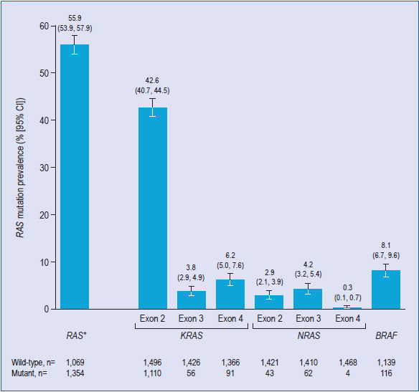
Results: Overall RAS Mutation Prevalence in All Patients With mCRC in the Three Phase III Studies
Peeters M, et al. J Clin Oncol. 2015;33(suppl 3): Abstract 520.

Slide 6
Results
RAS mutation prevalence was higher in females (P = .030)
RAS mutation prevalence was statistically significant between countries with over 50 patients included (P = .007)
The RAS mutation prevalence ranged from 45.1% (95% CI: [39.7%, 50.5%]) for Belgium to 65.6% (95% CI: [53.3%, 76.2%]) for France
The RAS mutation estimate varied by study with a significantly lower estimate observed in the phase III study reported by Douillard et al, 2010¹ and 2013² (P = .001)
BRAF mutation prevalence was 8.1% (95% CI: [6.7%, 9.6%])
1. Douillard JY, et al. J Clin Oncol. 2010;28(31):4697-4705. 2. Douillard JY, et al. N Engl J Med. 2013;369(11):1023-1034.
Peeters M, et al. J Clin Oncol. 2015;33(suppl 3): Abstract 520.

Slide 7
Conclusions
This large retrospective pooled analysis of randomized clinical trials provides the most robust prevalence estimates of RAS mutations to date
The overall prevalence of RAS mutations in mCRC patients was estimated as 55.9% (95% CI: [53.9%, 57.9%])
There seems to be little variation on RAS mutation prevalence across trial population demographics and clinical characteristics
The only variables showing differences in RAS prevalence were gender and country where the patient was enrolled
Peeters M, et al. J Clin Oncol. 2015;33(suppl 3): Abstract 520.

